Slide 1
Module 3: Linear Regression Part 2
Daesoo Lee,
Department of Mathematical Sciences, NTNU
26/01/2023

Slide 2
Recap

Slide 3
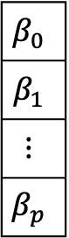
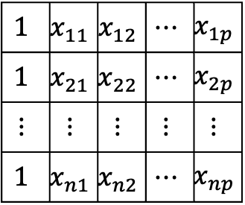
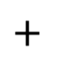
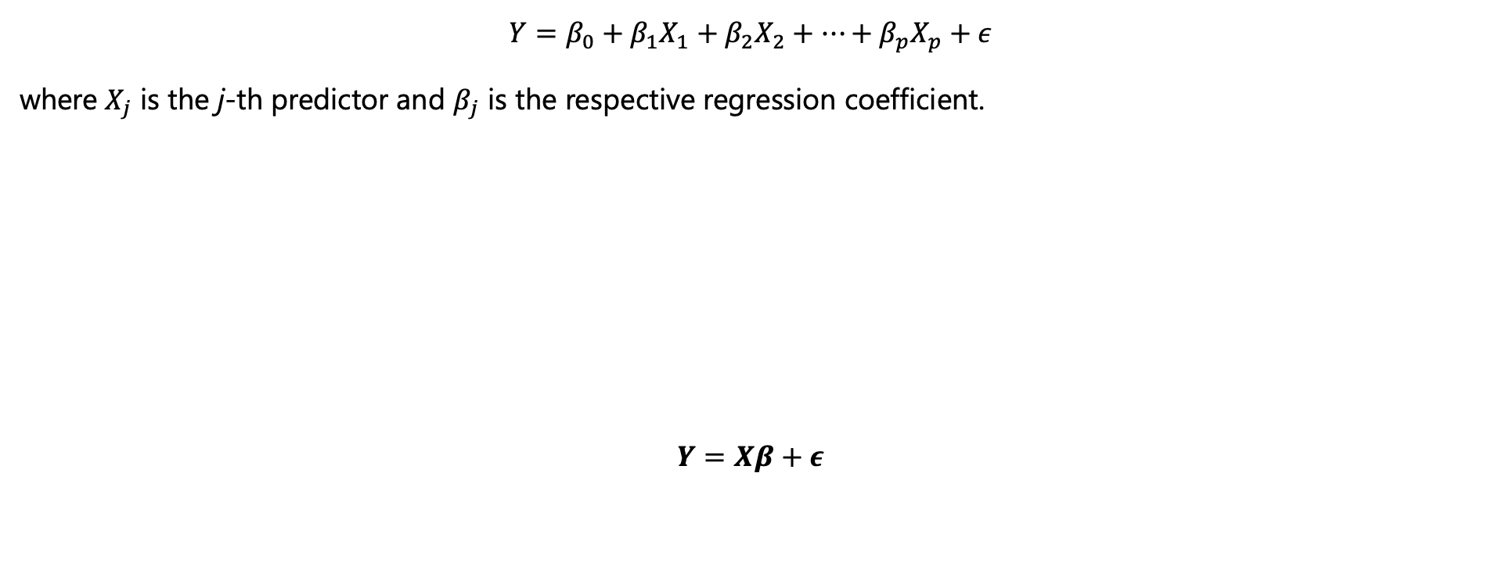
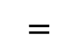
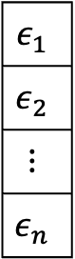
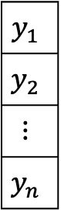

Recap
Model
$$Y=β_{0}+β_{1}X_{1}+β_{2}X_{2}+…+β_{p}X_{p}+ε$$
where $X_{j}$ is the j-th predictor and $β_{j}$ is the respective regression coefficient.
$$Y=Xβ+ε$$
$$y_{1}$$
$$y_{2}$$
$$⋮$$
$$y_{n}$$
$$1$$ | $$x_{11}$$ | $$x_{12}$$ | $$⋯$$ | $$x_{1p}$$
$$1$$ | $$x_{21}$$ | $$x_{22}$$ | $$⋯$$ | $$x_{2p}$$
$$⋮$$ | $$⋮$$ | $$⋮$$ | $$⋮$$ | $$⋮$$
$$1$$ | $$x_{n1}$$ | $$x_{n2}$$ | $$⋯$$ | $$x_{np}$$
$$β_{0}$$
$$β_{1}$$
$$⋮$$
$$β_{p}$$
$$ε_{1}$$
$$ε_{2}$$
$$⋮$$
$$ε_{n}$$
$$=$$
$$∙$$
$$+$$

Slide 4
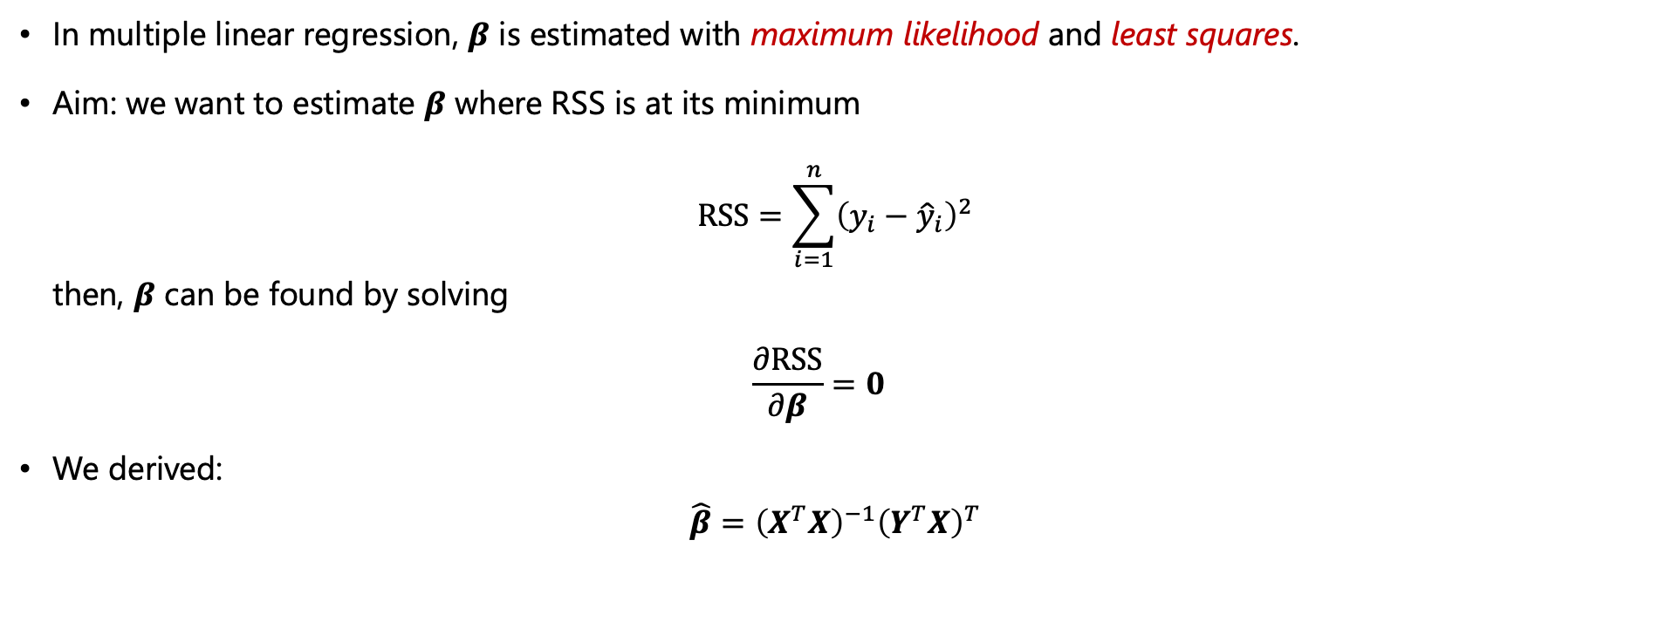

Recap
Parameter estimation for $β$
In multiple linear regression, $β$ is estimated with maximum likelihood and least squares.
Aim: we want to estimate $β$ where RSS is at its minimum $RSS=\sum_{i=1}^{n}{{\left(y_{i}−{\hat{y}}_{i}\right)}^{2}}$ then, $β$ can be found by solving $\frac{∂RSS}{∂β}=0$
We derived:
$$\hat{β}={\left(X^{T}X\right)}^{−1}{\left(Y^{T}X\right)}^{T}$$

Slide 5
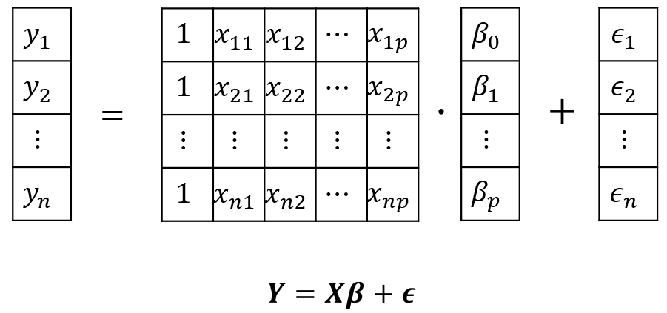
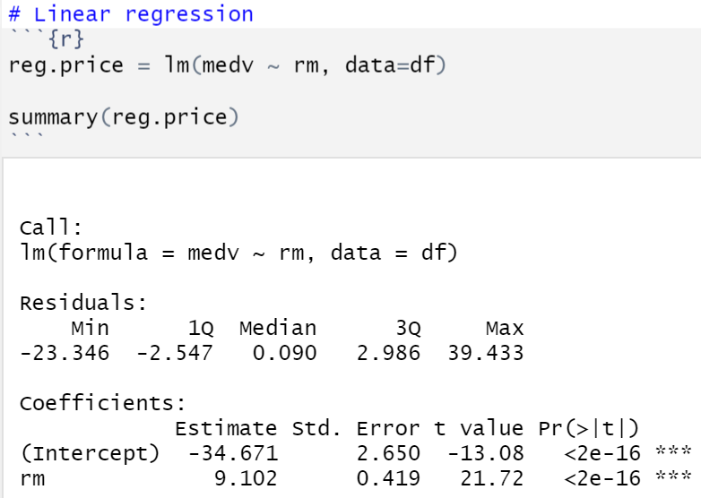
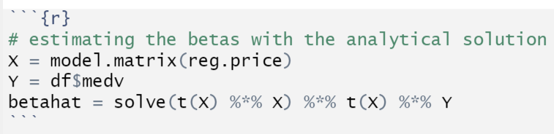
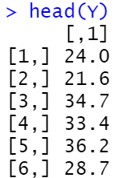
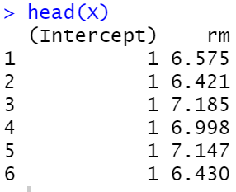
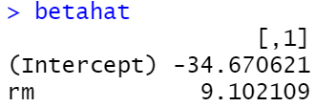
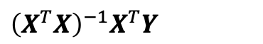
Recap
$$\hat{β}={\left(X^{T}X\right)}^{−1}{\left(Y^{T}X\right)}^{T}={\left(X^{T}X\right)}^{−1}X^{T}Y$$
$${\left(X^{T}X\right)}^{−1}X^{T}Y$$

Slide 6
Multiple Linear Regression (continued)

Slide 7
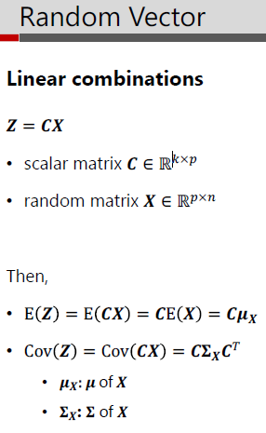
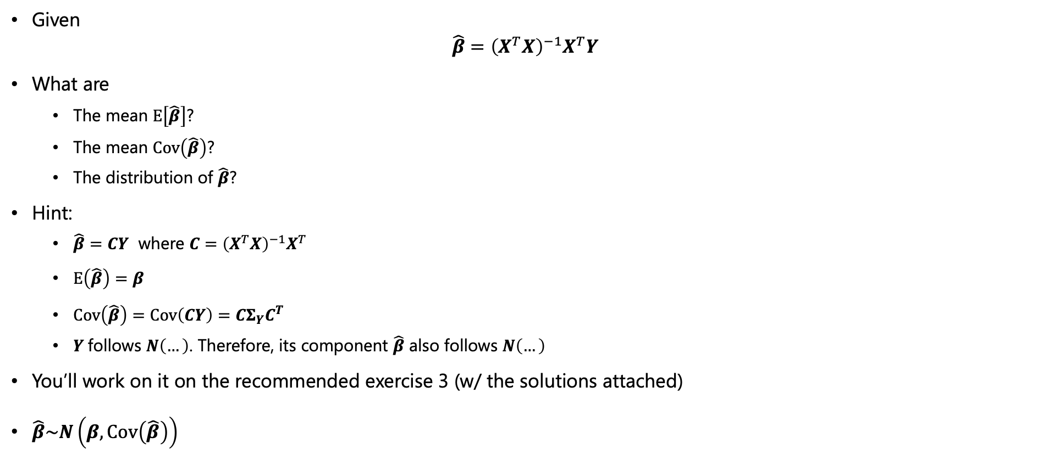

Multiple Linear Regression (continued)
Distribution of the regression parameter estimator
Given $\hat{β}={\left(X^{T}X\right)}^{−1}X^{T}Y$
What are
The mean $E\left[\hat{β}\right]$?
The mean $Cov\left(\hat{β}\right)$?
The distribution of $\hat{β}$?
Hint:
$\hat{β}=CY$ where $C={\left(X^{T}X\right)}^{−1}X^{T}$
$E\left(\hat{β}\right)=β$
$Cov\left(\hat{β}\right)=Cov\left(CY\right)=CΣ_{Y}C^{T}$
$Y$follows $N\left(…\right)$. Therefore, its component $\hat{β}$ also follows $N\left(…\right)$
You’ll work on it on the recommended exercise 3 (w/ the solutions attached)
$\hat{β}\sim N\left(β,Cov\left(\hat{β}\right)\right)$

Slide 8
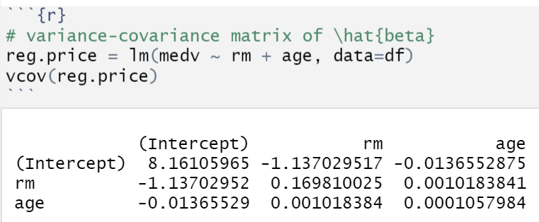
Multiple Linear Regression (continued)
The variance-covariance matrix of $\hat{β}$ in R

Slide 9
Four important questions

Slide 10
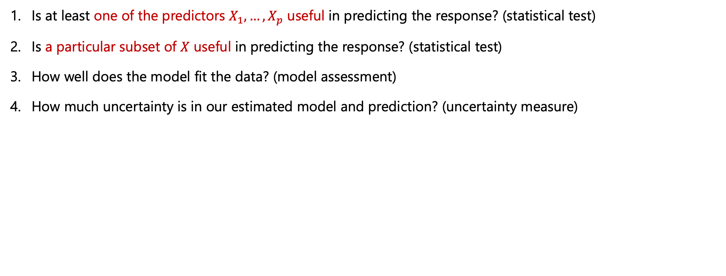
Four important questions
Is at least one of the predictors $X_{1},…,X_{p}$ useful in predicting the response? (statistical test)
Is a particular subset of $X$ useful in predicting the response? (statistical test)
How well does the model fit the data? (model assessment)
How much uncertainty is in our estimated model and prediction? (uncertainty measure)

Slide 11
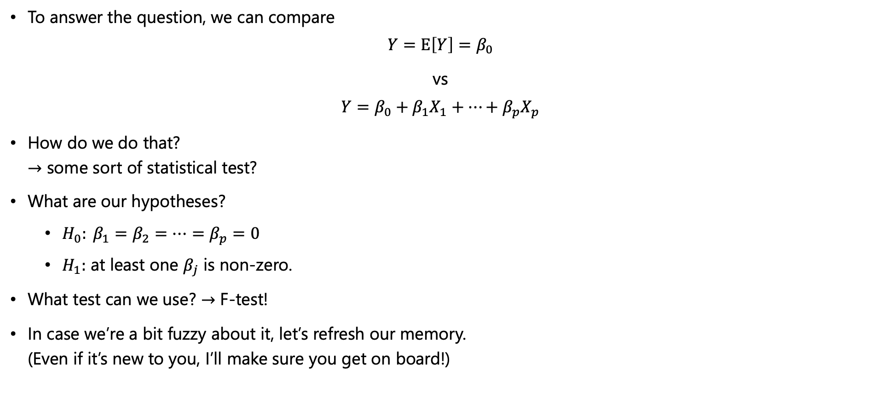
Four important questions
1. Is at least one of the predictors $X_{1},…,X_{p}$ useful in predicting the response?
To answer the question, we can compare
$$Y=E\left[Y\right]=β_{0}$$
vs
$$Y=β_{0}+β_{1}X_{1}+…+β_{p}X_{p}$$
How do we do that? $→$ some sort of statistical test?
What are our hypotheses?
$H_{0}: β_{1}=β_{2}=…=β_{p}=0$
$H_{1}:$ at least one $β_{j}$ is non-zero.
What test can we use? $→$ F-test!
In case we’re a bit fuzzy about it, let’s refresh our memory. (Even if it’s new to you, I’ll make sure you get on board!)

Slide 12

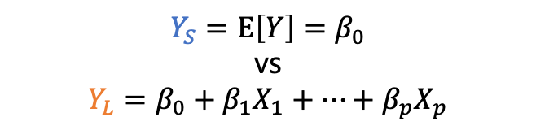
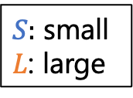


Four important questions
$$Y_{S}=E\left[Y\right]=β_{0}$$
vs
$$Y_{L}=β_{0}+β_{1}X_{1}+…+β_{p}X_{p}$$
$S:$ small
$L$: large
F-test
Are the two distributions statistically different from each other?
count
count
prediction error
prediction error
$$Y_{L}$$
$$Y_{S}$$
“statistically different”
“statistically not different”

Slide 13
Four important questions
$$Y_{S}=E\left[Y\right]=β_{0}$$
vs
$$Y_{L}=β_{0}+β_{1}X_{1}+…+β_{p}X_{p}$$
$S:$ small
$L$: large
F-test
It gets tricky in the real world
count
count
prediction error
prediction error
In short,
we want to measure if two distributions are different.
(not by my eyes but some systematic way)
“F-test”

Slide 14
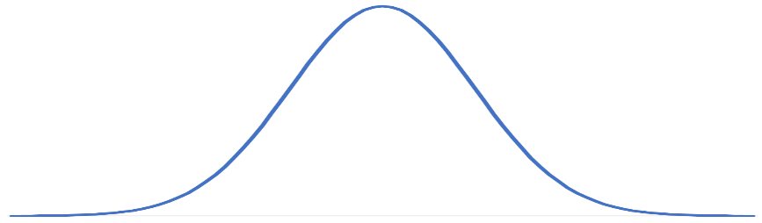
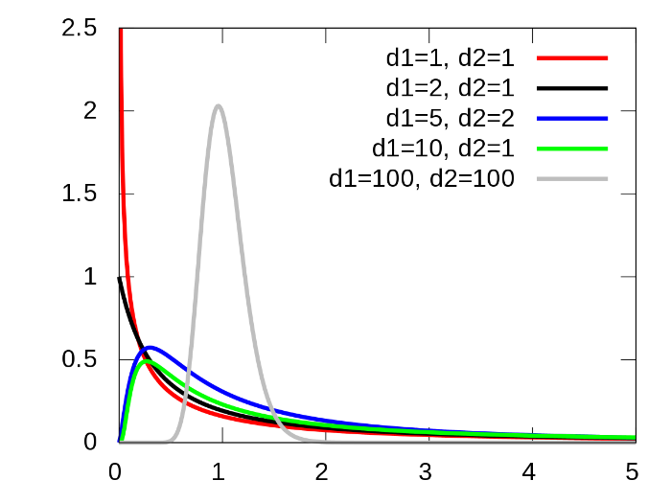
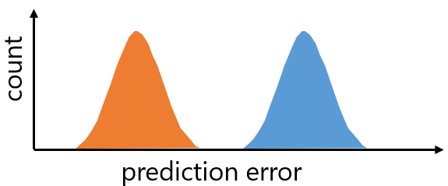
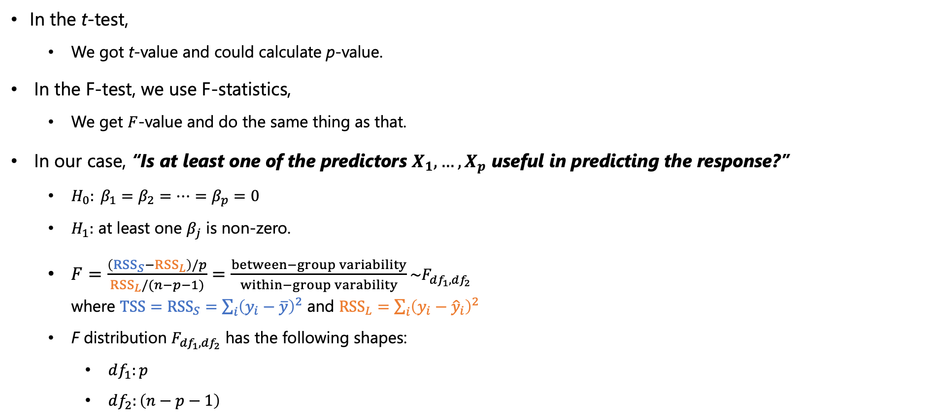
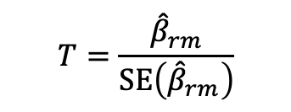



Four important questions
T distribution under $H_{0}$
F-test
In the t-test,
We got t-value and could calculate p-value.
In the F-test, we use F-statistics,
We get $F$-value and do the same thing as that.
In our case, “Is at least one of the predictors $X_{1},…,X_{p}$ useful in predicting the response?”
$H_{0}: β_{1}=β_{2}=…=β_{p}=0$
$H_{1}:$ at least one $β_{j}$ is non-zero.
$F=\frac{\left({RSS}_{S}−{RSS}_{L}\right)/p}{{RSS}_{L}/(n−p−1)}=\frac{between−group variability}{within−group varability}\sim F_{df_{1},df_{2}}$ where $TSS={RSS}_{S}=\sum_{i}{{\left(y_{i}−\overline{y}\right)}^{2}}$ and ${RSS}_{L}=\sum_{i}{{\left(y_{i}−{\hat{y}}_{i}\right)}^{2}}$
F distribution $F_{{df}_{1},{df}_{2}}$ has the following shapes:
$df_{1}:p$
$df_{2}:\left(n−p−1\right)$
$$T=\frac{{\hat{β}}_{rm}}{SE\left({\hat{β}}_{rm}\right)}$$
$$F_{{df}_{1},{df}_{2}}$$
between-group variability
within-group variability

Slide 15
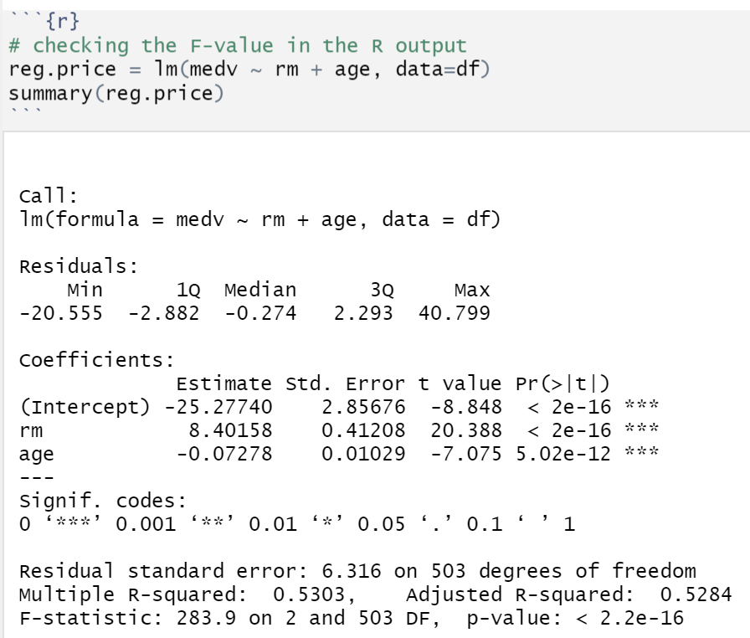
Four important questions
1. Is at least one of the predictors $X_{1},…,X_{p}$ useful in predicting the response?

Slide 16
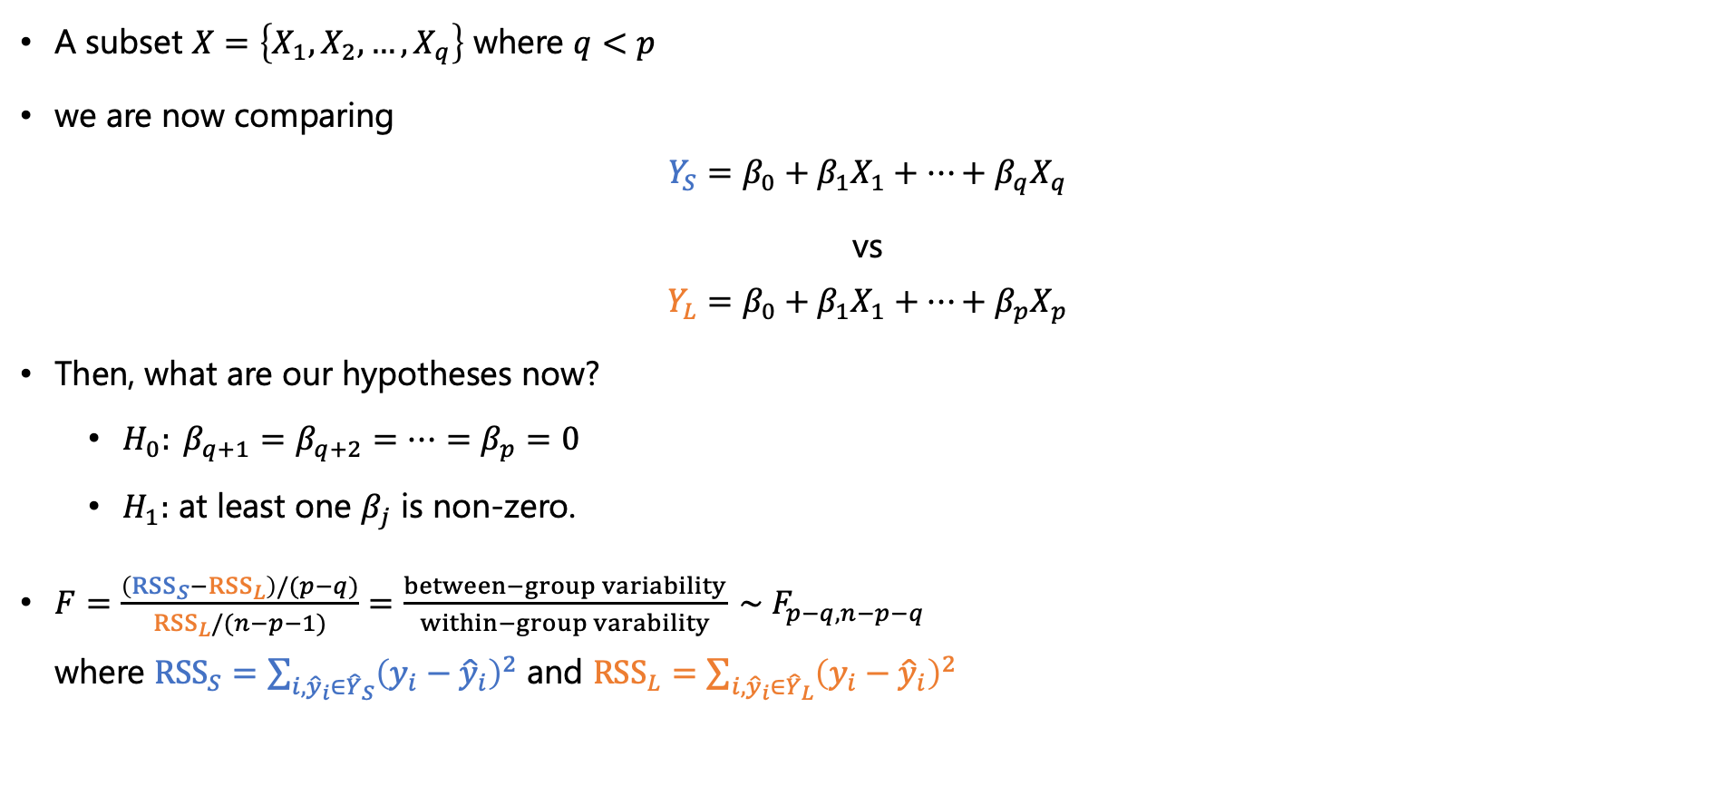
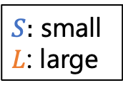
Four important questions
2. Is a particular subset of $X$ useful in predicting the response? (statistical test)
A subset $X=\left\{X_{1},X_{2},…,X_{q}\right\}$ where $q<p$
we are now comparing
$$Y_{S}=β_{0}+β_{1}X_{1}+…+β_{q}X_{q}$$
vs
$$Y_{L}=β_{0}+β_{1}X_{1}+…+β_{p}X_{p}$$
Then, what are our hypotheses now?
$H_{0}: β_{q+1}=β_{q+2}=…=β_{p}=0$
$H_{1}:$ at least one $β_{j}$ is non-zero.
$F=\frac{\left({RSS}_{S}−{RSS}_{L}\right)/(p−q)}{{RSS}_{L}/(n−p−1)}=\frac{between−group variability}{within−group varability} \sim F_{p−q, n−p−q}$ where ${RSS}_{S}=\sum_{i,{\hat{y}}_{i}∈{\hat{Y}}_{S}}{{\left(y_{i}−{\hat{y}}_{i}\right)}^{2}}$ and ${RSS}_{L}=\sum_{i,{\hat{y}}_{i}∈{\hat{Y}}_{L}}{{\left(y_{i}−{\hat{y}}_{i}\right)}^{2}}$
$S:$ small
$L$: large

Slide 17
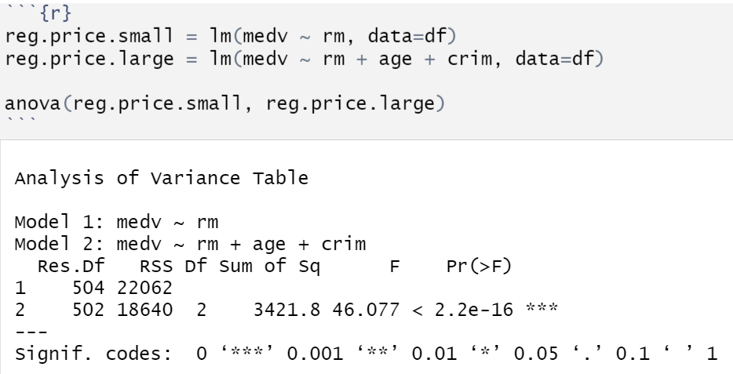
Four important questions
F-test in R
F-test is a subset of ANOVA

Slide 18
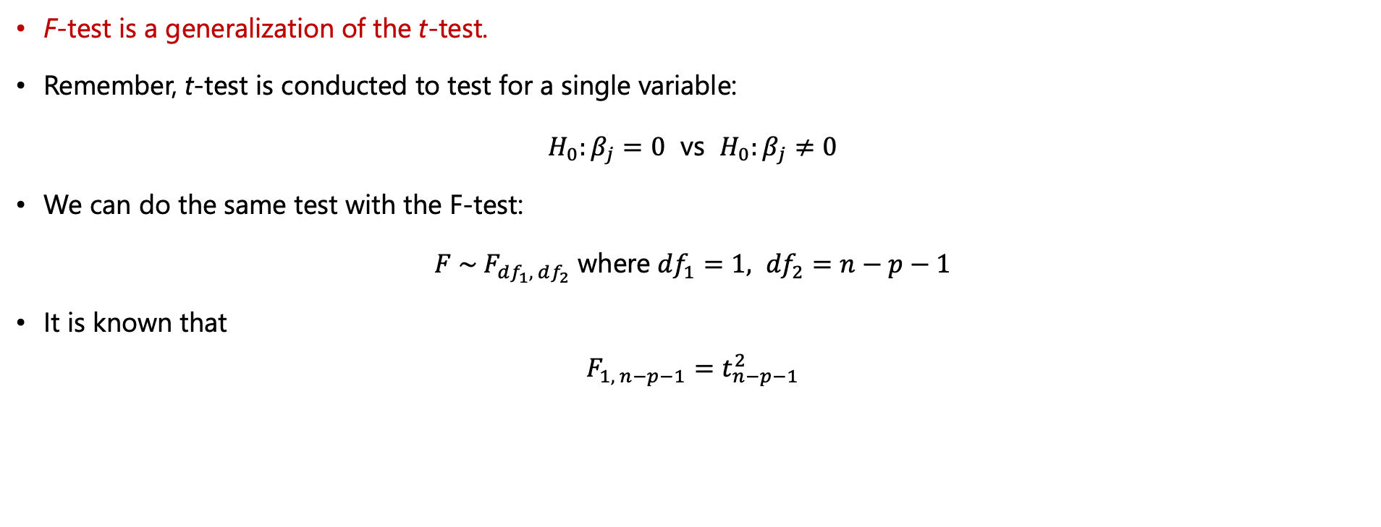
Four important questions
Relation between t-test and F-test
F-test is a generalization of the t-test.
Remember, t-test is conducted to test for a single variable:
$H_{0}:β_{j}=0$ vs $H_{0}:β_{j}≠0$
We can do the same test with the F-test:
$F \sim F_{df_{1}, df_{2}}$ where ${df}_{1}=1, {df}_{2}=n−p−1$
It is known that $F_{1, n−p−1}=t_{n−p−1}^{2}$

Slide 19
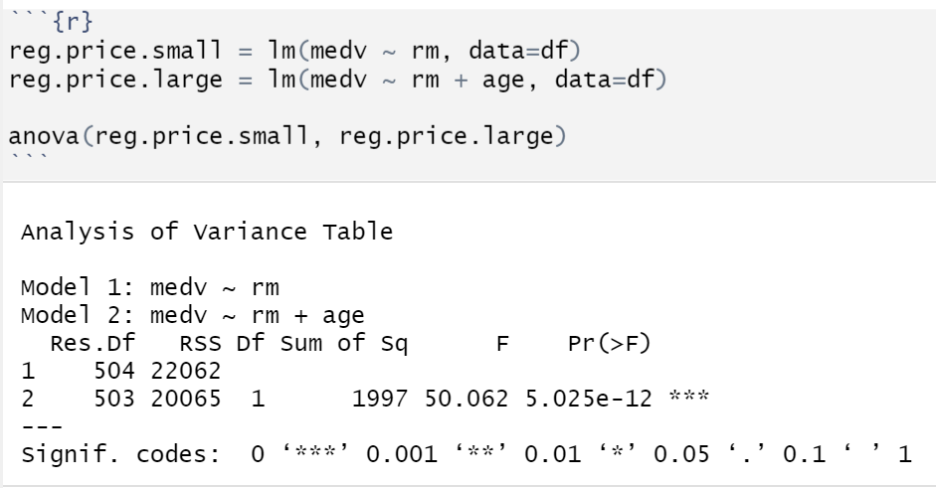
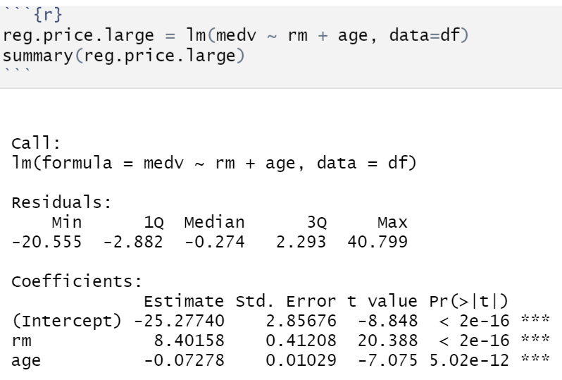



Four important questions
Relation between t-test and F-test
F-test for a single estimate, ${\hat{β}}_{age}$
t-test
$$F_{1, n−p−1}=t_{n−p−1}^{2}$$

Slide 20
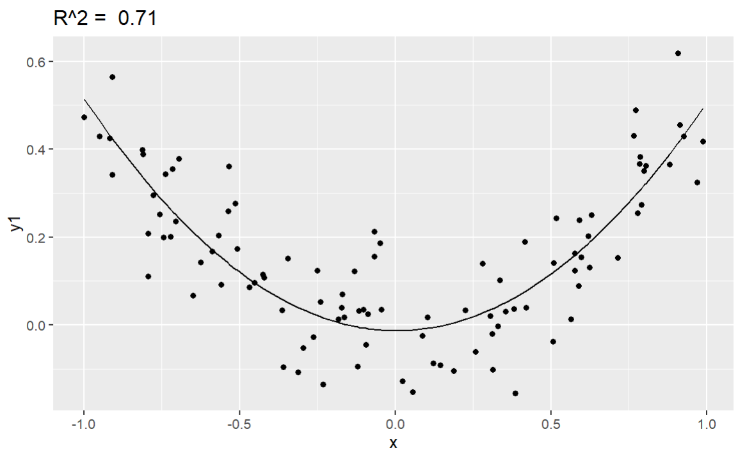
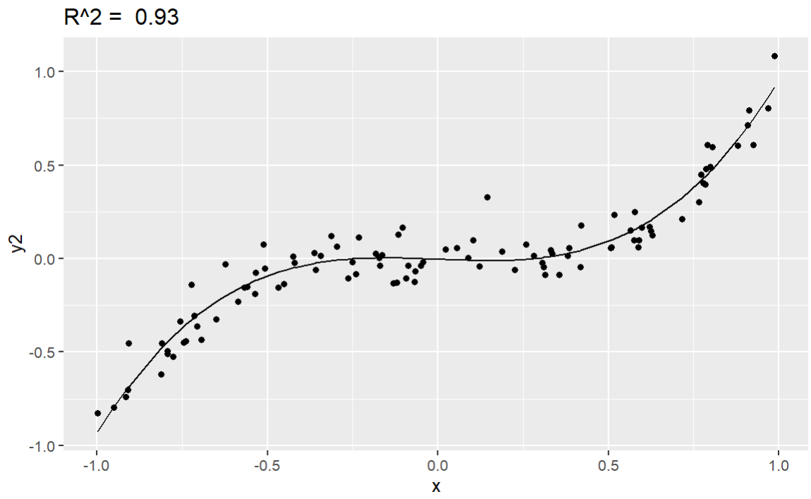
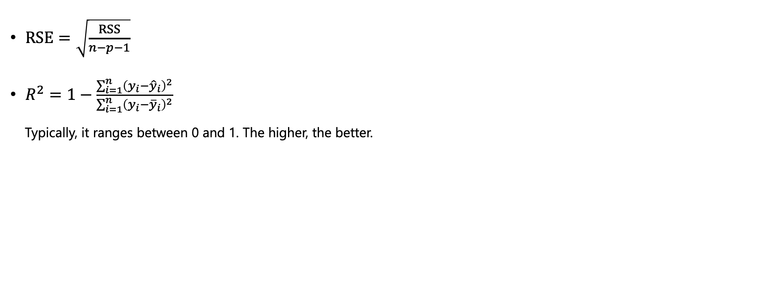
Four important questions
3. How well does the model fit the data?
$RSE=\sqrt{\frac{RSS}{n−p−1}}$
$R^{2}=1−\frac{\sum_{i=1}^{n}{{\left(y_{i}−{\hat{y}}_{i}\right)}^{2}}}{\sum_{i=1}^{n}{{\left(y_{i}−{\overline{y}}_{i}\right)}^{2}}}$
Typically, it ranges between 0 and 1. The higher, the better.
RSS: Residual Sum of Squares
RSE: Residual Standard of Error

Slide 21
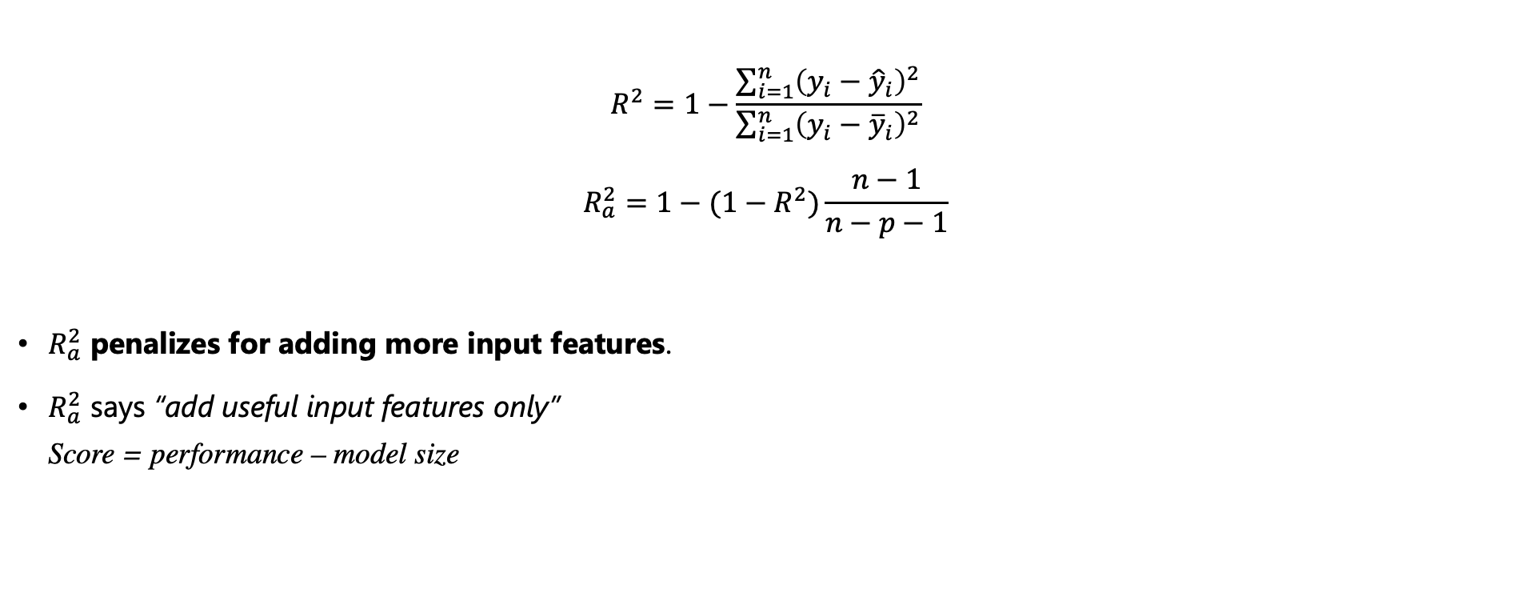
Four important questions
Adjusted $R^{2}$
$$R^{2}=1−\frac{\sum_{i=1}^{n}{{\left(y_{i}−{\hat{y}}_{i}\right)}^{2}}}{\sum_{i=1}^{n}{{\left(y_{i}−{\overline{y}}_{i}\right)}^{2}}}$$
$$R_{a}^{2}=1−(1−R^{2})\frac{n−1}{n−p−1}$$
$R_{a}^{2}$ penalizes for adding more input features.
$R_{a}^{2}$ says “add useful input features only” Score = performance – model size

Slide 22
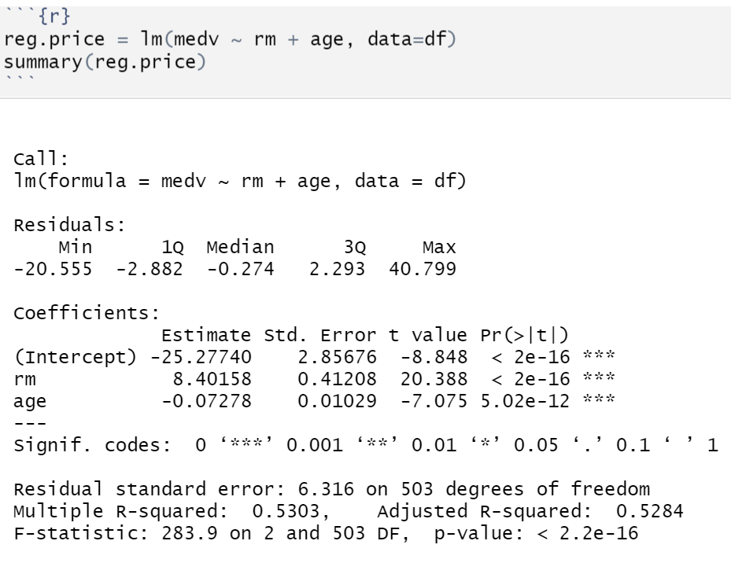
Four important questions
Adjusted $R^{2}$

Slide 23

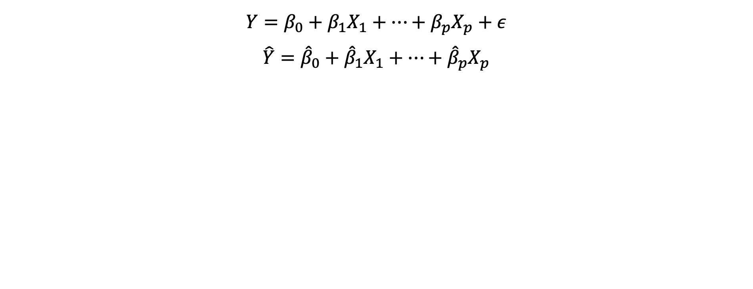
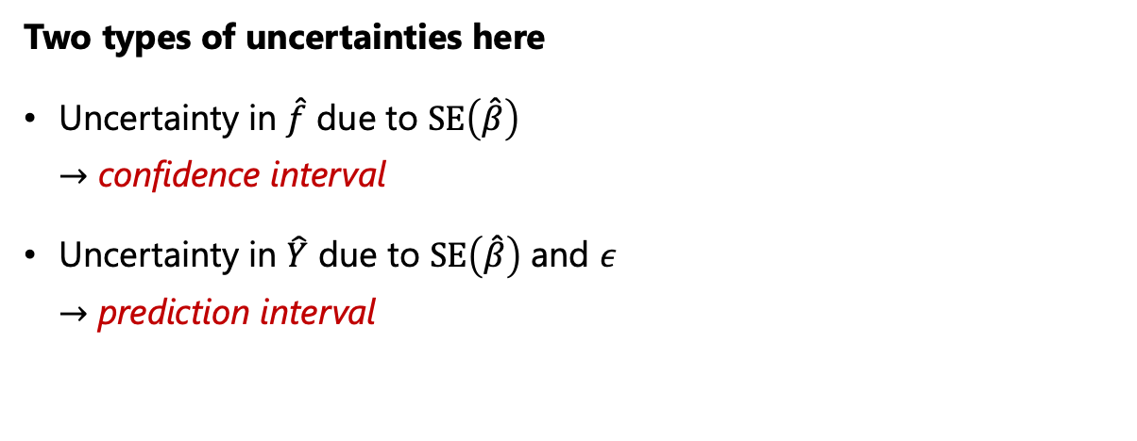


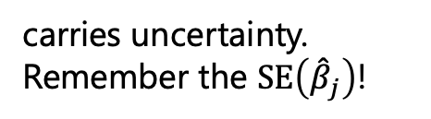
Four important questions
How much uncertainty is in our estimated model and prediction?
$$Y=β_{0}+β_{1}X_{1}+…+β_{p}X_{p}+ε$$
$$\hat{Y}={\hat{β}}_{0}+{\hat{β}}_{1}X_{1}+…+{\hat{β}}_{p}X_{p}$$
poses uncertainty to our prediction.
carries uncertainty.
Remember the $SE\left({\hat{β}}_{j}\right)$!
Two types of uncertainties here
Uncertainty in $\hat{f}$ due to $SE\left(\hat{β}\right)$ $→$ confidence interval
Uncertainty in $\hat{Y}$ due to $SE\left(\hat{β}\right)$ and $ε$ $→$ prediction interval

Slide 24
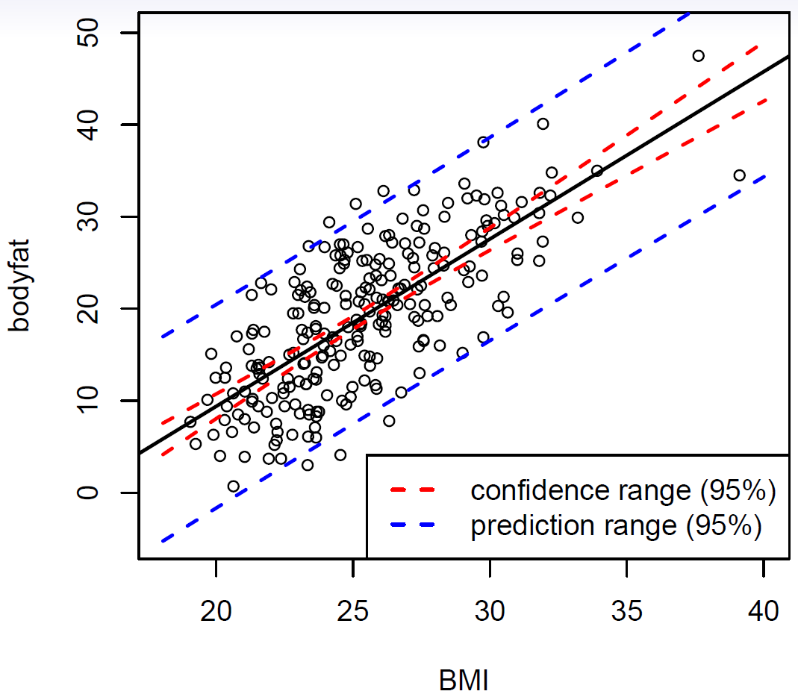
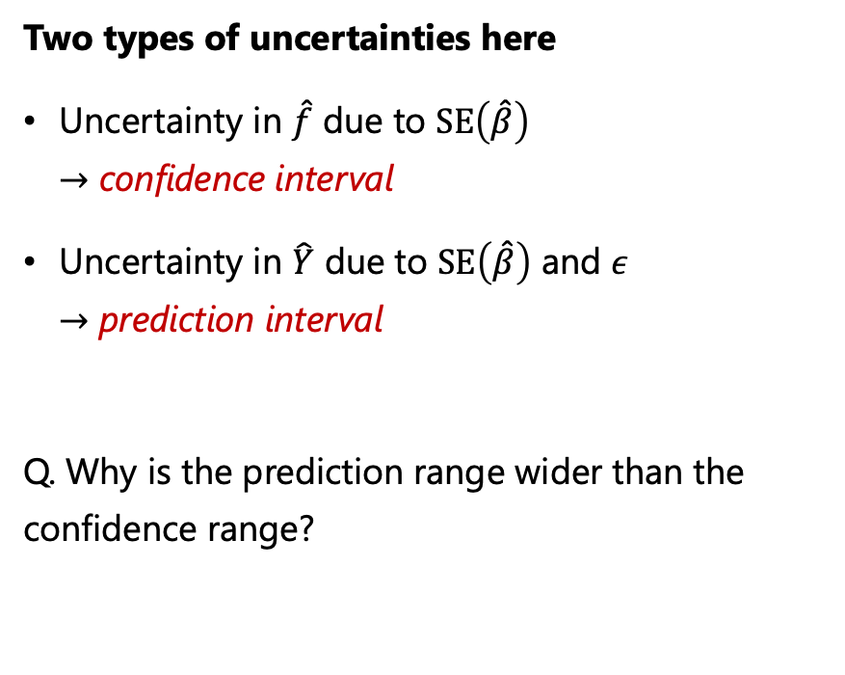
Four important questions
How much uncertainty is in our estimated model and prediction?
Two types of uncertainties here
Uncertainty in $\hat{f}$ due to $SE\left(\hat{β}\right)$ $→$ confidence interval
Uncertainty in $\hat{Y}$ due to $SE\left(\hat{β}\right)$ and $ε$ $→$ prediction interval
Q. Why is the prediction range wider than the confidence range?

Slide 25
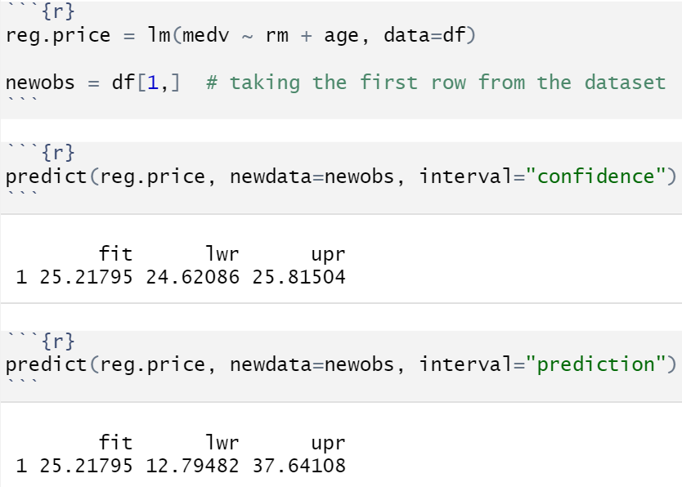
Four important questions
Confidence range and Prediction range in R

Slide 26
Extensions of the linear model

Slide 27
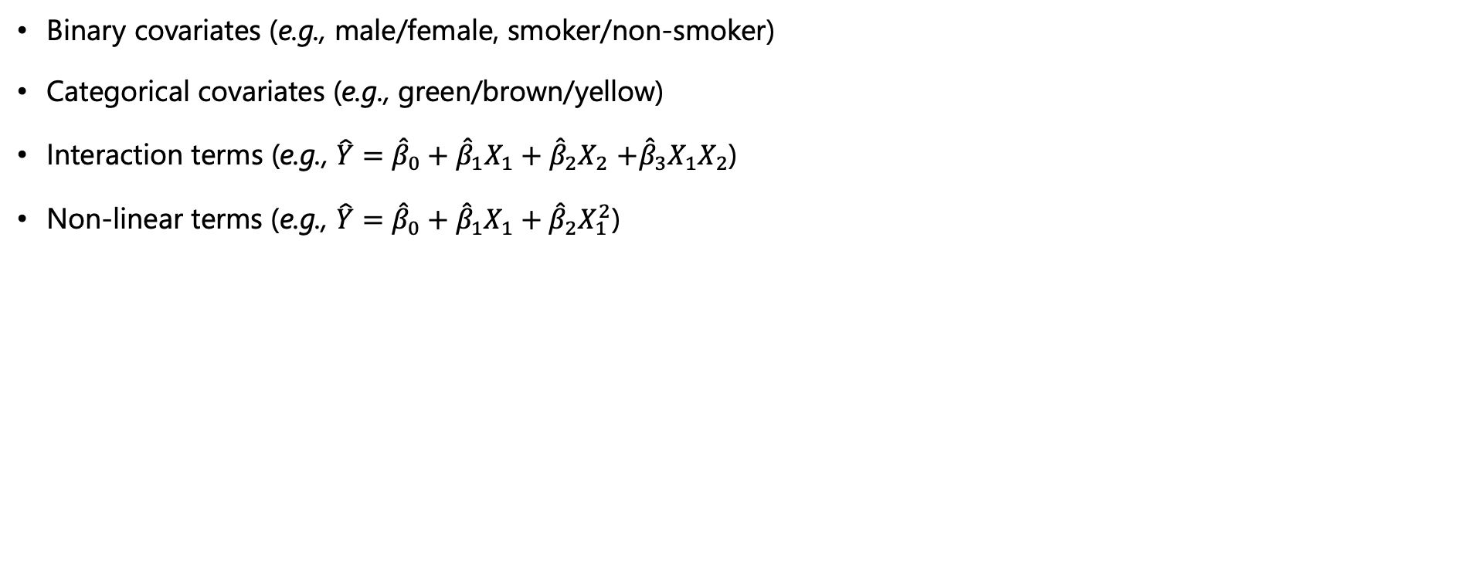
Extensions of the linear model
Extensions that make the linear model very powerful!
Binary covariates (e.g., male/female, smoker/non-smoker)
Categorical covariates (e.g., green/brown/yellow)
Interaction terms (e.g., $\hat{Y}={\hat{β}}_{0}+{\hat{β}}_{1}X_{1}+{\hat{β}}_{2}X_{2}$ $+{\hat{β}}_{3}X_{1}X_{2}$)
Non-linear terms (e.g., $\hat{Y}={\hat{β}}_{0}+{\hat{β}}_{1}X_{1}+{\hat{β}}_{2}X_{1}^{2}$)
Covariates == Input feature

Slide 28
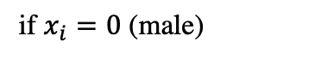
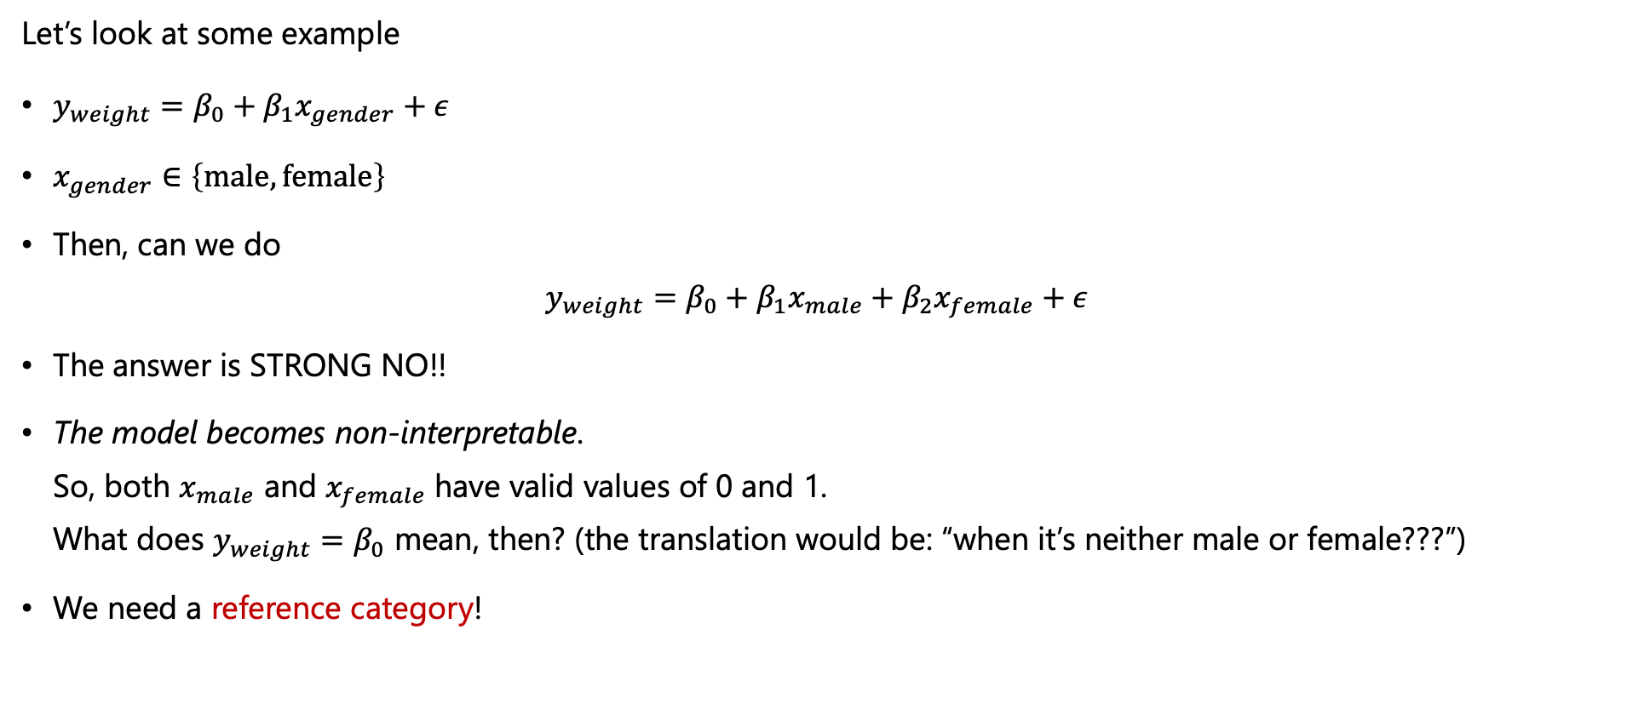
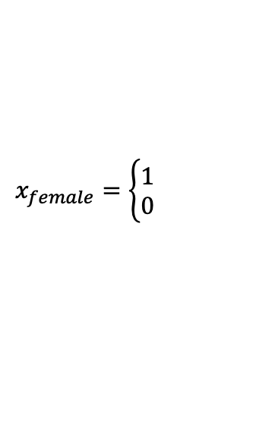
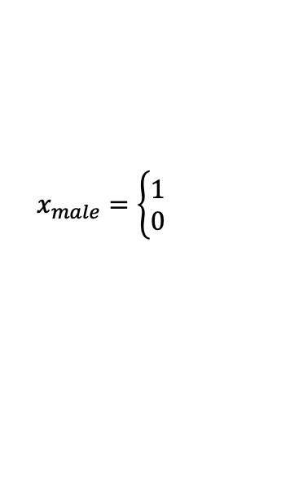

Extensions of the linear model
Binary predictors (covariate / input feature)
Let’s look at some example
$y_{weight}=β_{0}+β_{1}x_{gender}+ε$
$x_{gender}∈\left\{male, female\right\}$
Then, can we do $y_{weight}=β_{0}+β_{1}x_{male}+β_{2}x_{female}+ε$
The answer is STRONG NO!!
The model becomes non-interpretable. So, both $x_{male}$ and $x_{female}$ have valid values of 0 and 1. What does $y_{weight}=β_{0}$ mean, then? (the translation would be: “when it’s neither male or female???”)
We need a reference category!
$$x_{male}=\left\{\begin{aligned}1 \\ 0\end{aligned}\right.$$
If so,
otherwise
$$x_{female}=\left\{\begin{aligned}1 \\ 0\end{aligned}\right.$$
If so,
otherwise
if $x_{i}=0$ (male)
if $x_{i}=1$ (female)

Slide 29





Extensions of the linear model
Binary predictors (covariate / input feature)
$$x_{male}=\left\{\begin{aligned}1 \\ 0\end{aligned}\right.$$
If so,
Then, can we do $y_{weight}=β_{0}+β_{1}x_{male}+β_{2}x_{female}+ε$
The answer is STRONG NO!!
The model becomes non-interpretable. So, both $x_{male}$ and $x_{female}$ have valid values of 0 and 1. What does $y_{weight}=β_{0}$ mean, then? (the translation would be: “when it’s neither male or female?”) (ignore $ε$ for now)
We need a reference category! (i.e., we need a baseline)
We set “male” as the reference category (= baseline), then we’re actually saying $y_{weight}=β_{0}$ represents the male weight.
Then, when $x$ is female, we have $y_{weight}=β_{0}+β_{1}x_{female.compared.to.male}$
otherwise
$$x_{female}=\left\{\begin{aligned}1 \\ 0\end{aligned}\right.$$
If so,
otherwise
weight
$$β_{0}$$
$$x_{female.compared.to.male}=\left\{\begin{aligned}1 \\ 0\end{aligned}\right.$$
if female,
otherwise
male
female

Slide 30




Extensions of the linear model
Qualitative predictors (input features) with more than 2 levels
Let’s look at some example
$x_{education}∈\left\{below.collge,Bachelor, Master, PhD\right\}$
We set “below.college” as the reference category! Then,
$y_{income}=β_{0}+β_{1}x_{Bachelor↔below.college}+β_{2}x_{Master↔below.college}+β_{3}x_{PhD↔below.college}+ε$
That means, when $y_{income}=β_{0}$, $β_{0}$ refers to $y_{income}$ when the education level is below college.
Remember a number of $β$ for $k$-level qualitative variable is $k−1$.
$$x_{Bachelor↔below.college}=\left\{\begin{aligned}1 \\ 0\end{aligned}\right.$$
if Bachelor,
otherwise
$$x_{Master↔below.college}=\left\{\begin{aligned}1 \\ 0\end{aligned}\right.$$
if Master,
otherwise
$$x_{PhD↔below.college}=\left\{\begin{aligned}1 \\ 0\end{aligned}\right.$$
if PhD,
otherwise
Terminology: $x_{red},x_{blue},x_{green}$ are called dummy variables.

Slide 31

Extensions of the linear model
Example
We’re now using a new dataset, named Credit from the ISLR library

Slide 32
Extensions of the linear model
Example: Introducing a new dataset
We’re now using a new dataset, named Credit from the ISLR library
Column names: "ID" "Income" "Liit" "Rating" "Cards" "Age" "Education" "Gender" "Student" "Married" "Ethnicity" "Balance"

Slide 33


Extensions of the linear model
Example: Linear regression model with a qualitative input variable.
$${\hat{y}}_{rating}={\hat{β}}_{0}+{\hat{β}}_{1}x_{student.yes}$$
The refernece category is ”not student”
When $x$ is not a student,
$${\hat{y}}_{rating}={\hat{β}}_{0}=355.04$$
When $x$ is a student,
$${\hat{y}}_{rating}={\hat{β}}_{0}+{\hat{β}}_{1}x_{student.yes}=355.04−1.04×1$$

Slide 34


Extensions of the linear model
Example: Linear regression model with a qualitative input variable.
There are three ethnicities: African American, Asian, Caucasian
Cards: a number of credit cards
The refernece category is ”African American”
${\hat{y}}_{cards}={\hat{β}}_{0}+{\hat{β}}_{1}x_{Asian↔American}$ $+{\hat{β}}_{1}x_{Caucasian↔American}$
When $x$ is Afican American,
$${\hat{y}}_{cards}={\hat{β}}_{0}=2.96$$
When $x$ is Asian,
$${\hat{y}}_{cards}={\hat{β}}_{0}+\hat{β}x_{Asian↔American}=2.96+0.01×1$$
$$\text{W}\text{hen} x \text{is} \text{Caucasian}\text{,}$$
$${\hat{y}}_{cards}={\hat{β}}_{0}+{\hat{β}}_{1}x_{Caucasian↔American}=2.96−0.01×1$$

Slide 35


Extensions of the linear model
Testing for a qualitative input variable (=categorical predictor)
Question: Is Ethnicity a useful feature to predict Cards?
Statistical testing can be used to answer the question
$$H_{0}: β_{1}=β_{2}=0$$
vs
$H_{1}:$ at least one $β_{j}$ is non-zero.
We can use F-test.

Slide 36
Extensions of the linear model
Testing for a qualitative input variable (=categorical predictor)
We can use F-test.

Slide 37

Extensions of the linear model
Interaction terms
Let’s say, we were initially modeling with the following two input variables: {Student, Age}
$$y_{rating}=β_{0}+β_{1}x_{student.yes}+β_{2}x_{age}+ε$$
where the reference category for Student is ”not student” and $x_{age}$ is a quantitative variable.
Then, we want to add some “interaction term” as:
$$y_{rating}=β_{0}+β_{1}x_{student.yes}+β_{2}x_{age}+β_{3}x_{student.yes}x_{age}+ε$$
Then,
$$y_{rating}=\left\{\begin{aligned}β_{0}+β_{1}+\left(β_{2}+β_{3}\right)x_{age}+ε \\ β_{0}+β_{2}x_{age}+ε \end{aligned}\right.$$
NB! We now allow different slops and intercepts for the different two groups (i.e., students and non-students).
if student,
otherwise,

Slide 38





Extensions of the linear model
Interaction terms
$$y_{rating}=β_{0}+β_{1}x_{student.yes}+β_{2}x_{age}+β_{3}x_{student.yes}x_{age}+ε$$

Slide 39

Extensions of the linear model
The hierarchical principle
If we include an interaction term in a model, we should always include the main effects.
For instance, if you’re modeling $y_{rating}=β_{0}+β_{1}x_{student.yes}+β_{2}x_{age}+β_{3}x_{student.yes}x_{age}+ε$
You can’t remove the main term(s) of the interaction term: $y_{rating}=β_{0}+β_{1}x_{student.yes}+β_{3}x_{student.yes}x_{age}+ε$
The further explanation is given on p. 89 in the ISLR book.

Slide 40

Extensions of the linear model
Non-linear terms
Let’s say we have a basic linear model:
$$y_{i}=β_{0}+β_{1}x_{i}+ε$$
Then, we want to add non-linear terms by transforming the existing variable, $y_{i}=β_{0}+β_{1}x_{i}+β_{2}x_{i}^{2}+ε$
More of it? $y_{i}=β_{0}+β_{1}x_{i}+β_{2}x_{i}^{2}+β_{3}x_{i}^{3}+ε$
Other common transformations are:
log
$\sqrt{… }$
sin, cos, etc.

Slide 41

Extensions of the linear model
Non-linear terms
How can you call that a linear regression model? $Y=β_{0}+β_{1}X_{1}+β_{2}X_{1}^{2}+ε$
The word linear refers to the linearity in the coefficients, If we consider $X_{2}=X_{1}^{2}$, then $Y=β_{0}+β_{1}X_{1}+β_{2}X_{2}+ε$
Often, our world is not linear, and we need some non-linearity to express that.
We’ll learn about fancier non-linear methods in a later module!

Slide 42
Challenges – for model fit

Slide 43

Challenges – for model fit
Recap of modeling assumptions in linear regression
The assumptions in linear regression is that the residuals $ε$ follow a normal distribution, $ε\sim N\left(0,σ^{2}\right)$ implying that:
$E\left(ε_{i}\right)=0$
$Var\left(ε_{i}\right)=σ^{2}$
$ε_{i}$ are normally distributed.
$ε_{i}$ are independent of each other.
To make valid inference from our model, our model assumptions should be fulfilled!

Slide 44


Challenges – for model fit
Modeling checking tool 1: Tukey-Anscombe diagram
Modeling assumptions:
$E\left(ε_{i}\right)=0$
$Var\left(ε_{i}\right)=σ^{2}$
$ε_{i}$ are normally distributed.
$ε_{i}$ are independent of each other.
We can check 1, 2 (and sort of 4)

Slide 45


Challenges – for model fit
Model checking tool 2: The QQ-diagram
Modeling assumptions:
$E\left(ε_{i}\right)=0$
$Var\left(ε_{i}\right)=σ^{2}$
$ε_{i}$ are normally distributed.
$ε_{i}$ are independent of each other.
We can check 3.
If the points lie roughly on a straight line, the data is fairly normally distributed.

Slide 46


Challenges – for model fit
Modeling checking tool 3: The scale-location plot
Modeling assumptions:
$E\left(ε_{i}\right)=0$
$Var\left(ε_{i}\right)=σ^{2}$
$ε_{i}$ are normally distributed.
$ε_{i}$ are independent of each other.
We can check 2.
We also want the blue line to be straight (i.e., no pattern in the residual)

Slide 47





Challenges – for model fit
Modeling checking tool 4: The leverage plot
What is the leverage?
Low leverage
weight = residual
High leverage

Slide 48


Challenges – for model fit
Modeling checking tool 4: The leverage plot
In simple regression, the leverage is defined as
$$H_{ii}=\frac{1}{n}+\frac{{\left(x_{i}−\overline{x}\right)}^{2}}{\sum_{i^{′}}{{\left(x_{i^{′}}−\overline{x}\right)}^{2}}}$$
It’s useful to determine outliers.
Watch out the samples with high leverage and high residual.
high residual
High leverage

Slide 49
Challenges – for model fit
Interactive material to see the leverage effects
https://seeing-theory.brown.edu/regression-analysis/index.html

Slide 50

Challenges – for model fit
Diagnostic plots in R
We can use autoplot() from the ggfortify package
https://bookdown.org/Maxine/r4ds/ggfortify.html

Slide 51
Self-study

Slide 52
Self-study
Further explanation regarding the leverages and collinearity.
The recorded video by Stefanie Muff is available here:
https://ntnu.cloud.panopto.eu/Panopto/Pages/Viewer.aspx?id=110f5d7b-6d50-4c61-8984-acbc00fe3d02

Slide 53

Self-study

Slide 54

Self-study

Slide 55

Self-study

Slide 56

Self-study

Slide 57

Self-study

Slide 58

Self-study

Slide 59

Self-study

Slide 60

Self-study

Slide 61

The End!

Slide 62



Four important questions
1. Is at least one of the predictors $X_{1},…,X_{p}$ useful in predicting the response?
To answer the question, we can compare
$$Y=E\left[Y\right]=β_{0}$$
vs
$$Y=β_{0}+β_{1}X_{1}+…+β_{p}X_{p}$$
How do we do that? $→$ some sort of statistical test?
What are our hypotheses?
$H_{0}: β_{1}=β_{2}=…=β_{p}=0$
$H_{1}:$ at least one $β_{j}$ is non-zero.
What test can we use? $→$ F-test!
In case we’re a bit fuzzy about it, let’s refresh our memory. (Even if it’s new to you, I’ll make sure you get on board!)
$X$ is not that useful
$X$ is useful
For $Y=β_{0}+β_{1}X_{1}$

